Slide 1


Slide 2

What Are Limits of OCR?
Dino Grgić
dino.grgic1@gmail.com

Slide 3
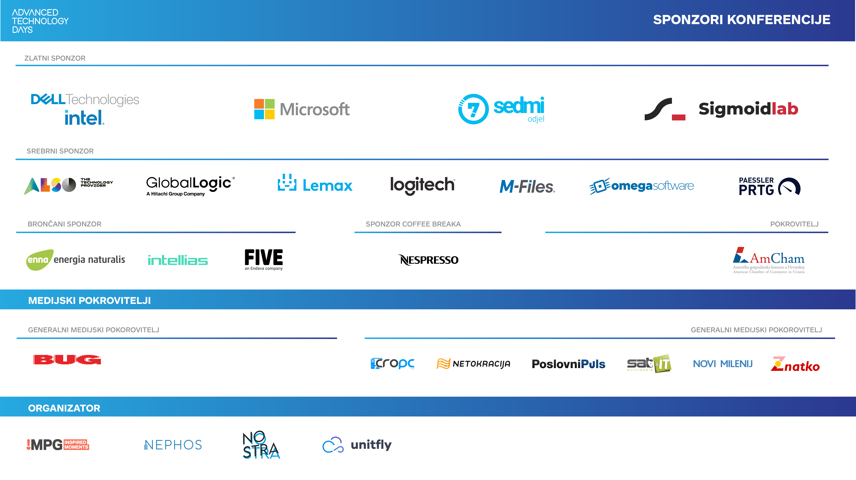

Slide 4

Agenda
Introduction to Computer Vision and OCR
How do we do OCR?
What are the latest trends?
Some state-of-the-art research examples

Slide 5

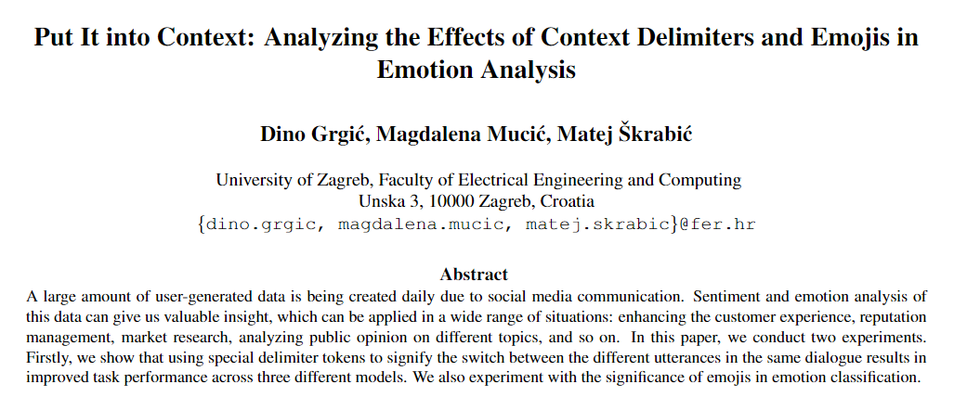
Who Am I?
Junior Software Engineer Student at Unitfly
since 2020
Computer Science masters’ student at FER
research in AI image/video upscale
some experience in NLP research

Slide 6
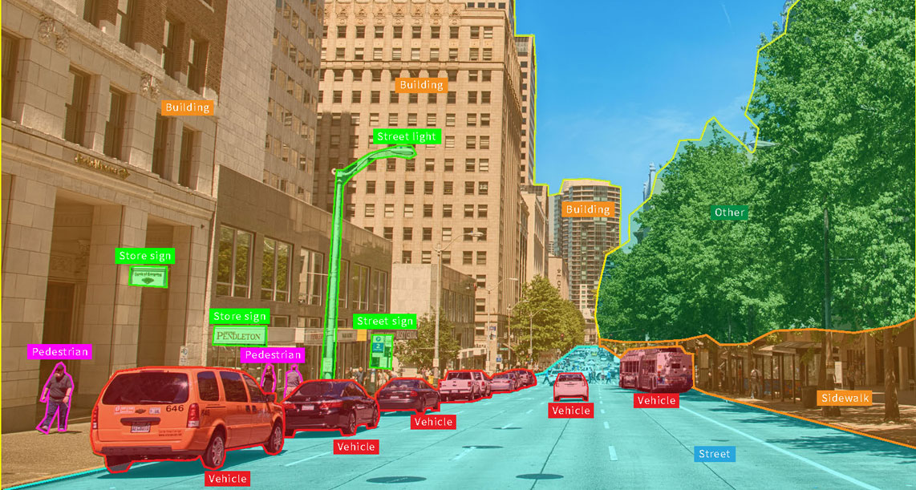
What Is Computer Vision?
field of computer science
TASK: enable computers to identify and understand objects in images and video
source https://appen.com

Slide 7
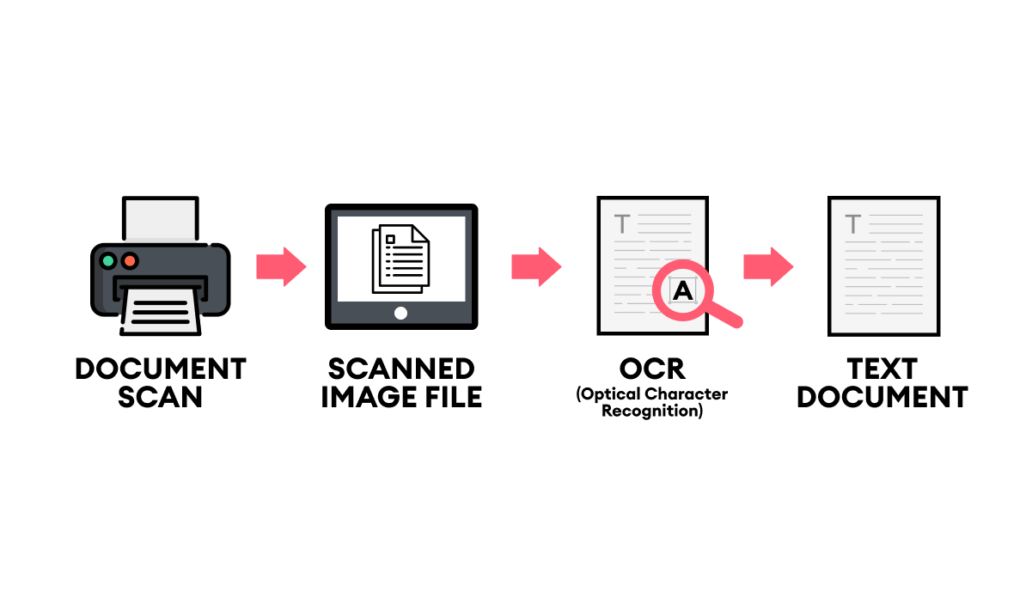
What Is OCR?
task of computer vision
Optical Character Recognition
text in image → machine readable text data
source: https://www.superannotate.com

Slide 8
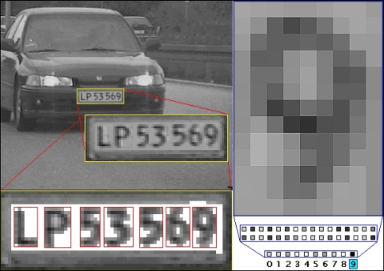
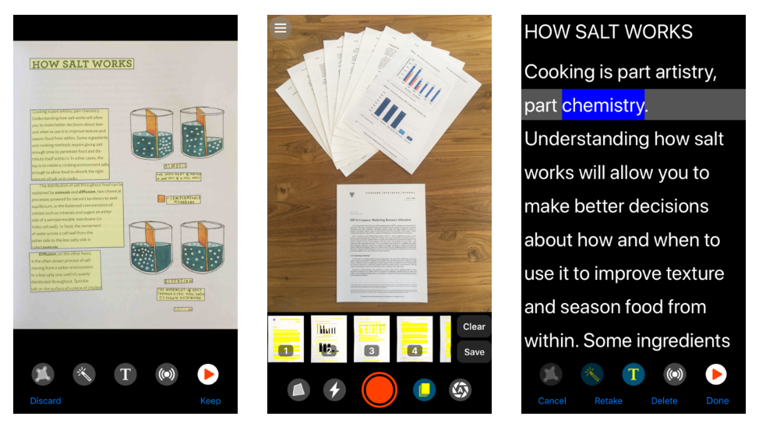
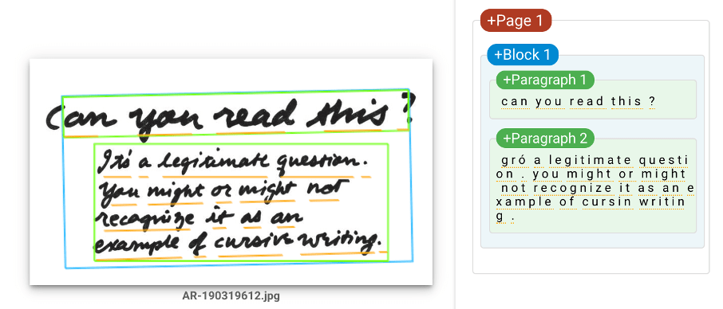
Where Is OCR Used?
traffic sign recognition
scanning license plates
aids for visually impaired
data entry for business documents
converting handwritten notes to machine-readable text
…

Slide 9
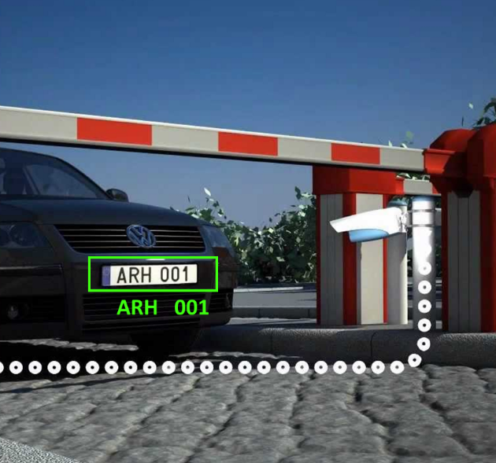
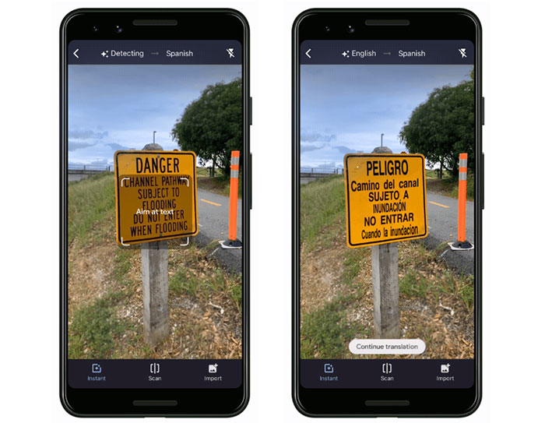
Where Is OCR Used?

Slide 10
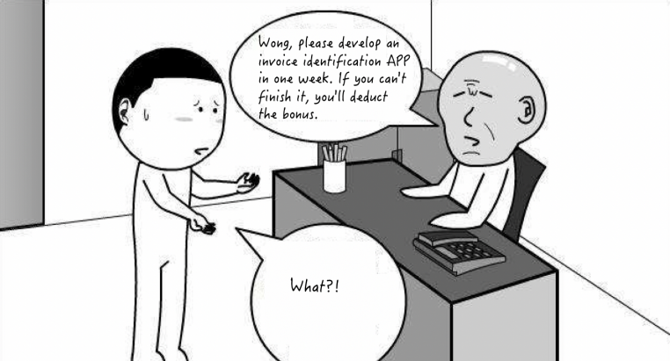

Slide 11
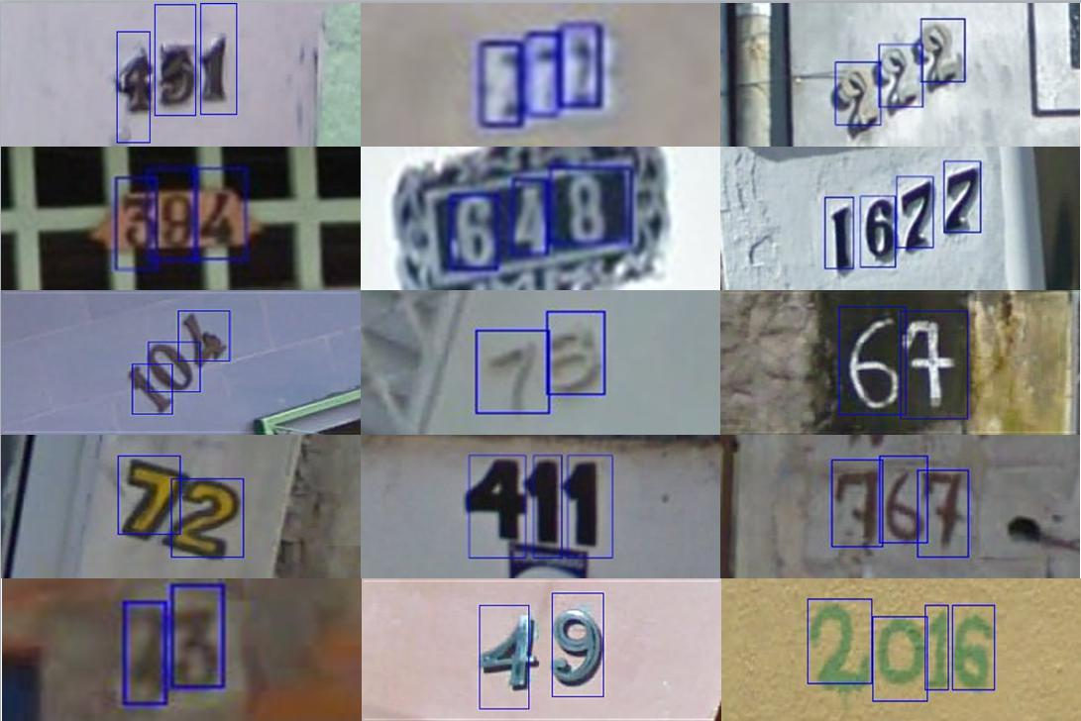
What Do We Need for OCR?
Model
pretrained
train on your own
Dataset
Unstructured
Structured
No free lunch!

Slide 12
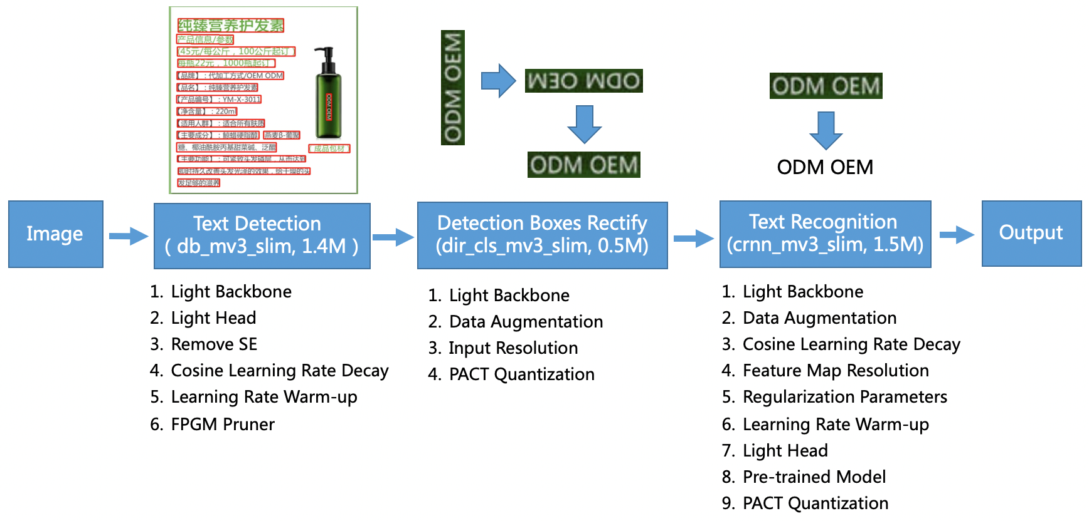
How We Do OCR?
Approach
Computer Vision
Deep Learning
(mostly) 3 step process
Pre-processing
Text detection + text recognition
Post-processing

Slide 13
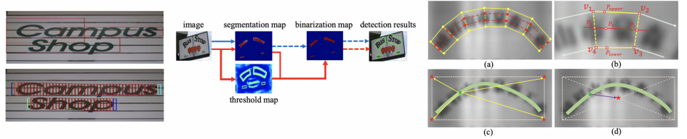
Text Detection
locate text regions in the input image
problem: bounding box of the text

Slide 14
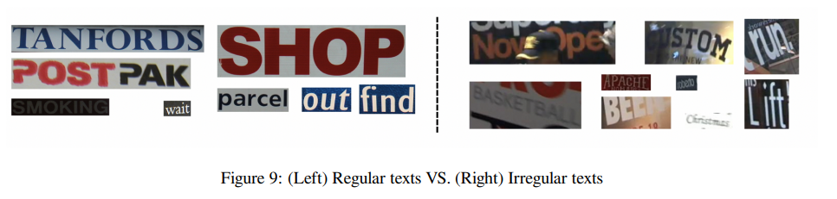
Text Recognition
extract text from input image
uses input from text detection
two categories
regular text
irregular text – research focus

Slide 15
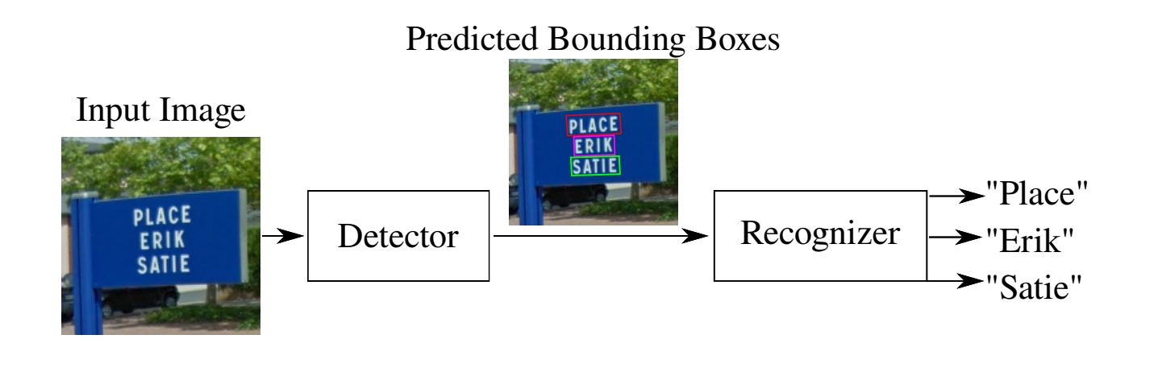
Text Detection vs Text Recognition
text detection = detect placement of the text in image
text recognition = extract the text

Slide 16
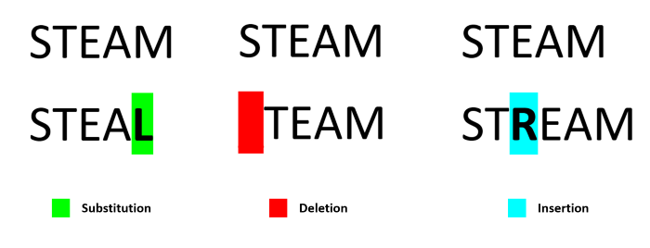
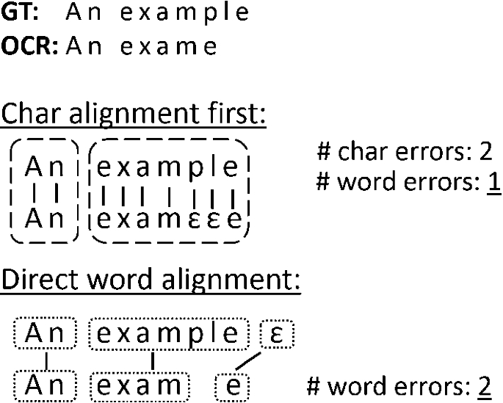
How Good Is OCR Model?
evaluation metrics
CER (%) – Character Error Rate
less is better
how are we correct with characters
WER (%) – Word Error Rate
less is better
how are we correct with words
Sequence Accuracy (%)
more is better
the whole sequence must be correct
Notes:
https://lubbil-com.ngontinh24.com/article/evaluate-ocr-output-quality-with-character-error-rate-cer-and-word-error-rate-wer

Slide 17
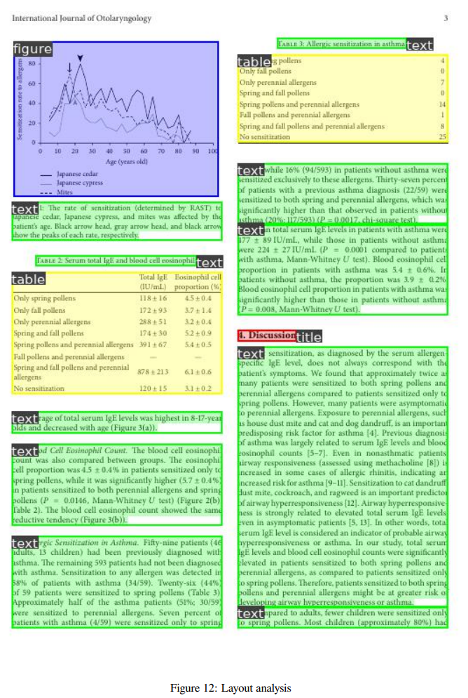
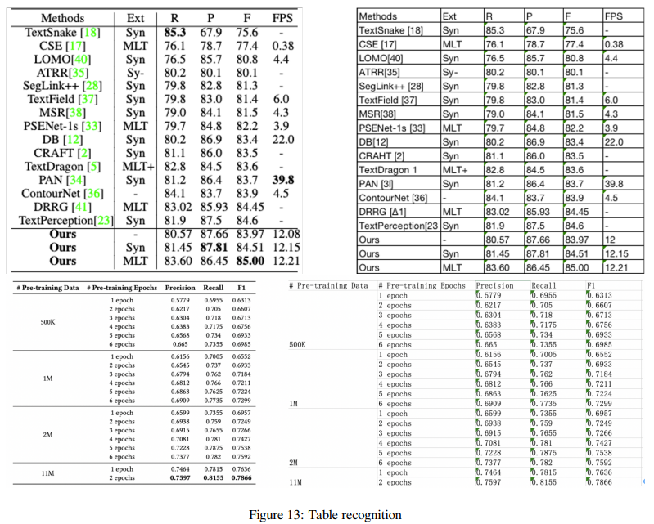
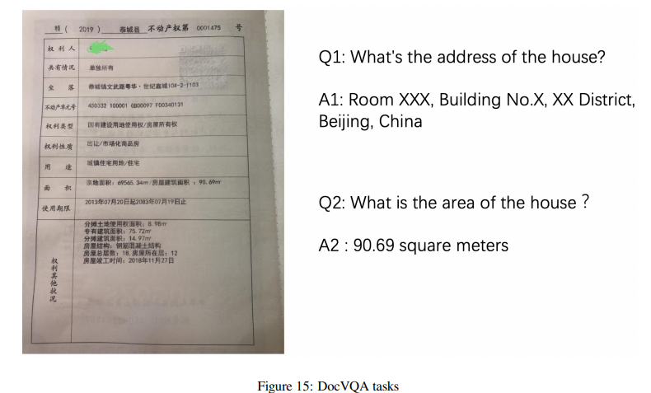
Document Structure Recognition
Layout Analysis
structure of the document
Table Recognition
table content extraction
Key Information Extraction

Slide 18
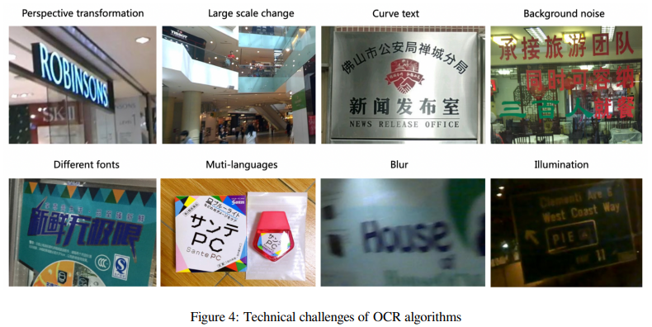
Current OCR Challenges
source: https://github.com/PaddlePaddle/PaddleOCR

Slide 19
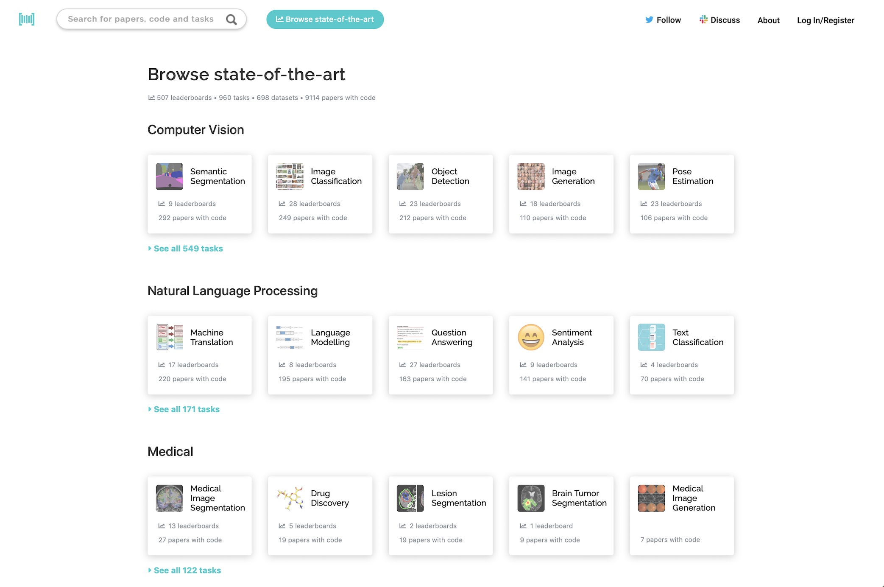
Following ML Trends
paperswithcode.com
public OCR tools
Azure Computer Vision
scientific conference / meetings
OCR
ICDAR – International Conference on Document Analysis and Recognition
NLP
ACL – Association for Computational Linguistics

Slide 20
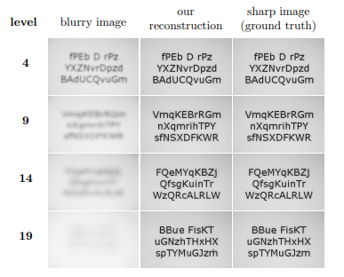
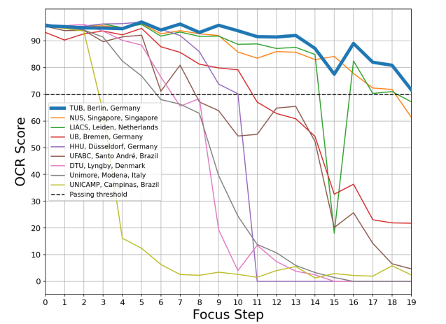
Research Example (2022)
Solving problem: Pre-processing - Blur
Let's Enhance: A Deep Learning Approach to Extreme Deblurring of Text Image (Trippe et al., 2022)
Technische Universität Berlin & Utrecht University
Helsinki Deblur Challenge 2021 (1st place)

Slide 21
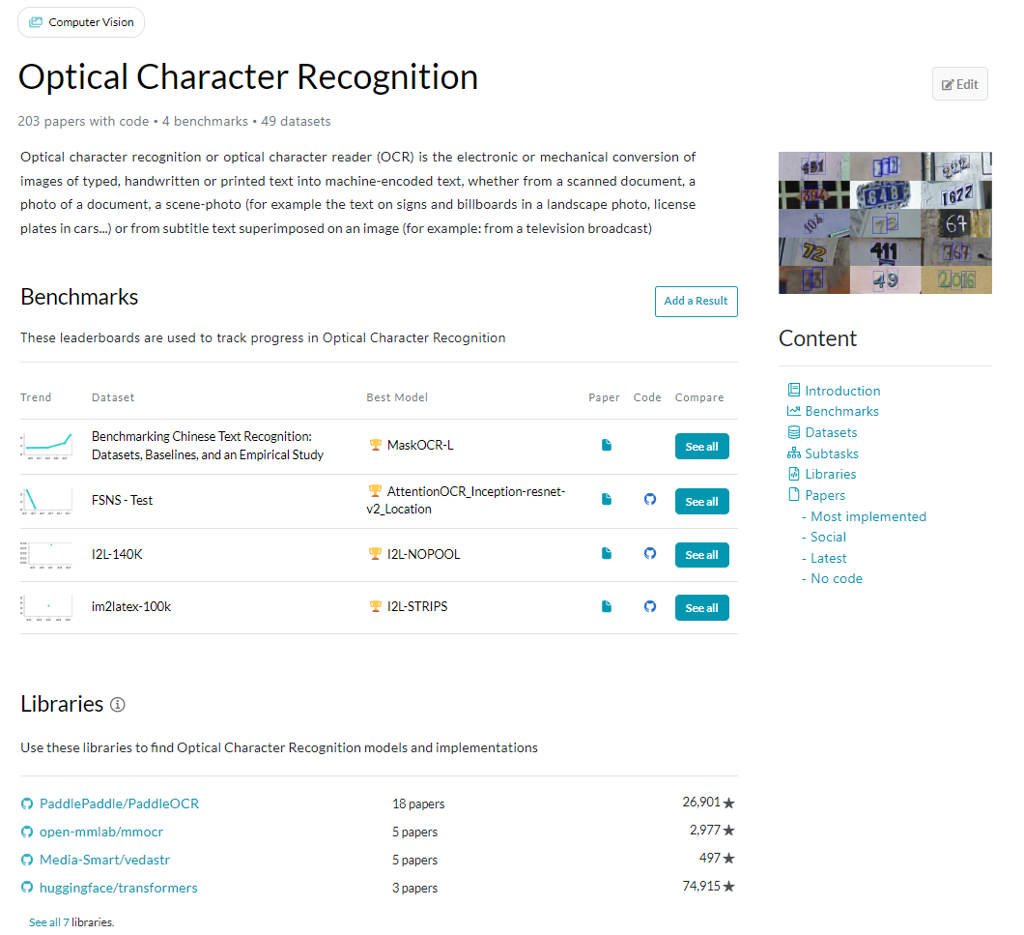
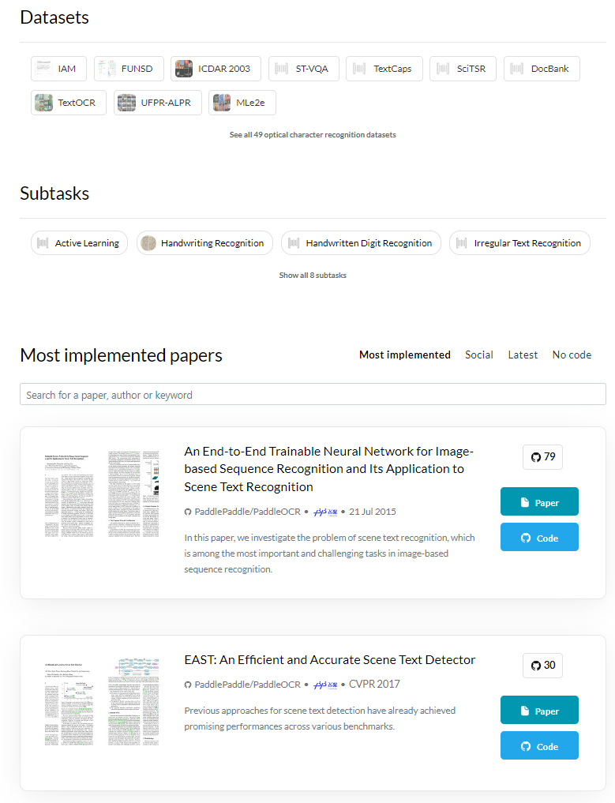

Slide 22
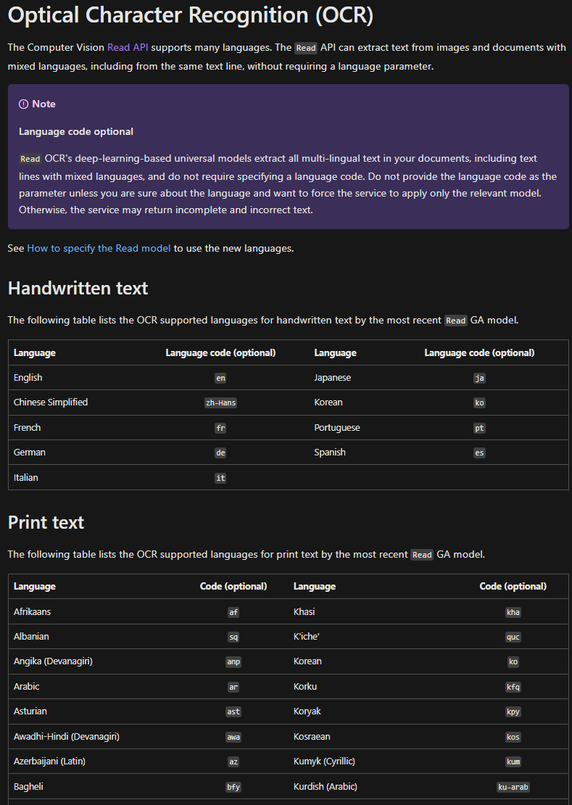
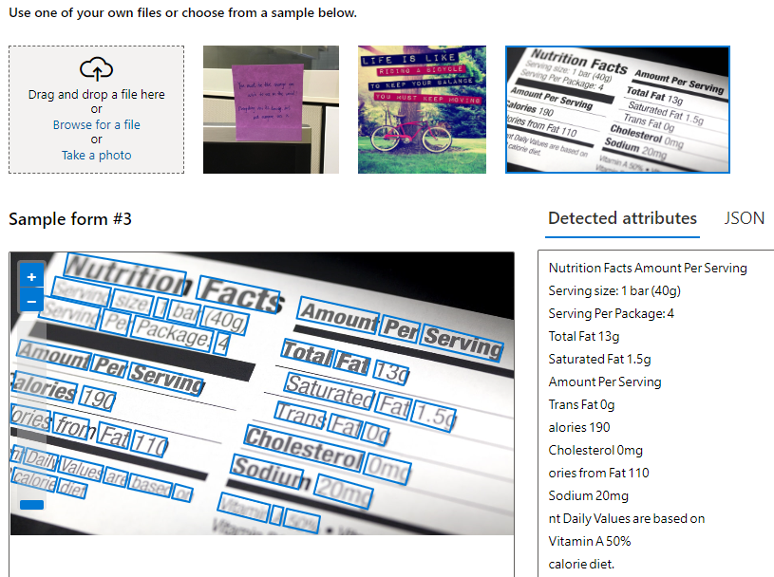
Azure Computer Vision

Slide 23
Is OCR Solved?
there are always problems to be solved
no model is 100% accurate
OCR is base for many systems
OCR improvement → CV models improvement

Slide 24
Demo

Slide 25
Useful Links
https://paperswithcode.com/sota
https://dl.acm.org/doi/10.1145/1273445.1273458
https://github.com/PaddlePaddle/PaddleOCR

Slide 26
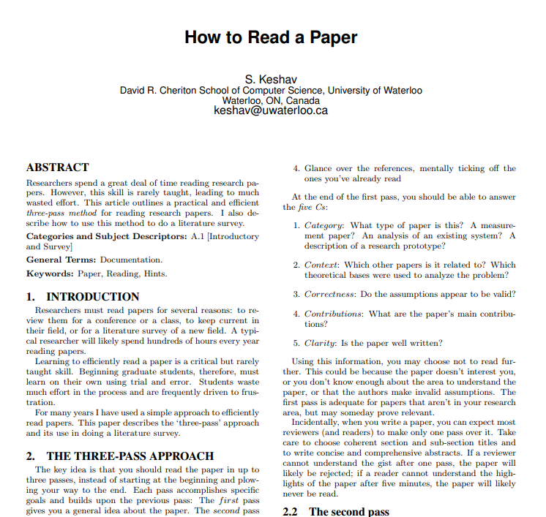
Digression: Reading Papers
How to Read a Paper (Keshav, 2007)
three pass approach
Pass one – least technical
Reading only the title, abstract, and first paragraph of each section
5 – 10 minutes
Pass two
Everything but details (formulas, figures, code)
1 hour
Pass three – most technical
Fully understand the paper
4-5 hours

Slide 27
Questions?

